Slide 1
Epson rc+
PDE4424 Industrial Manipulators
Judhi Prasetyo & Bittu Scaria
Middlesex University Dubai

Slide 2
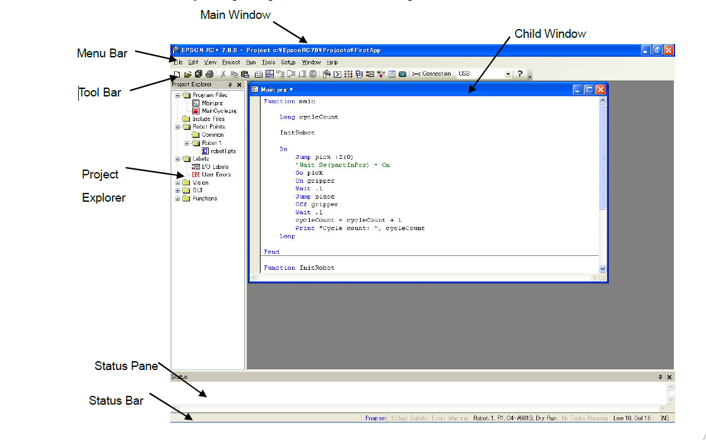
GUI Overview

Slide 3
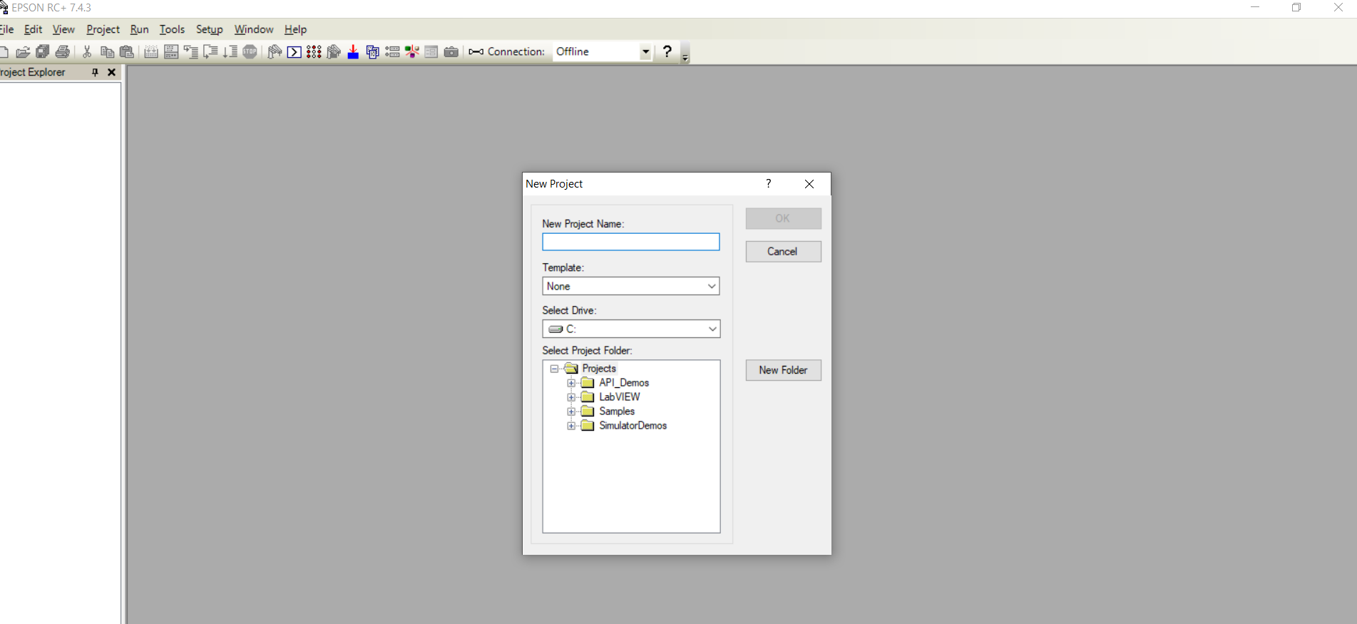
Project
Project New
Name the project
Select Template if required

Slide 4
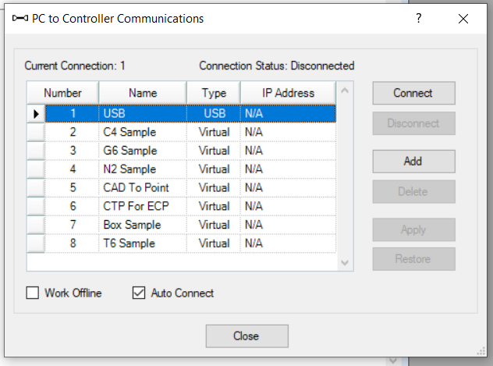
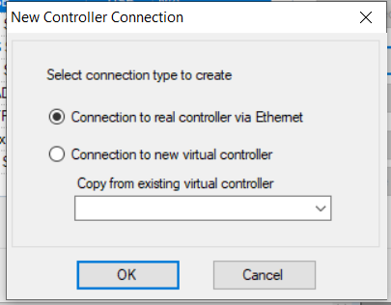
Establish Communication
1) Setup PC to Controller Communications…
2) “Add” (press add will give following screen)
3) For creating virtual controller select
“Connection to new virtual controller”

Slide 5
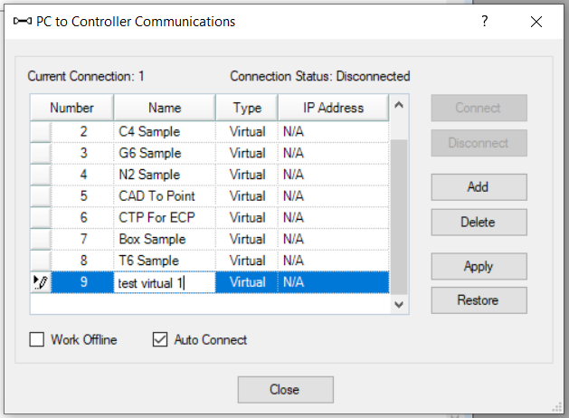
Following screen appears with option to enter a new Virtual Controller Name
Select “Apply” after editing the Name
followed with “Connect”
This will make the system to connect
new virtual controller created

Slide 6
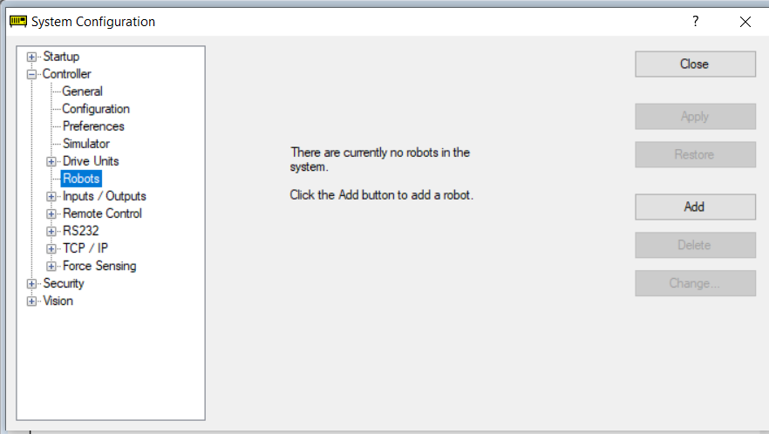
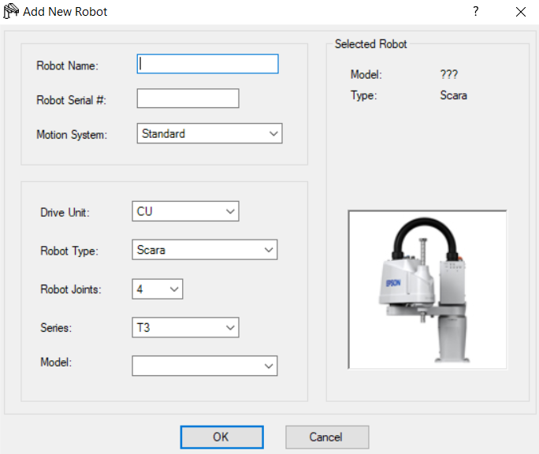
Adding Robot
1)Setup System Configuration Controller Robots
2) Select “Add”
3) Enter the Robot details

Slide 7
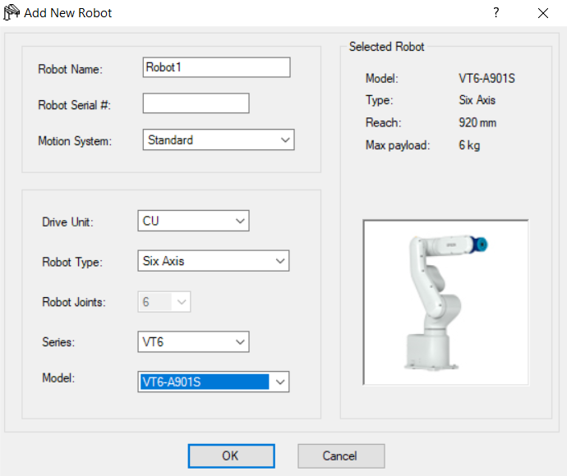
Entering the details and configuring robot as below

Slide 8
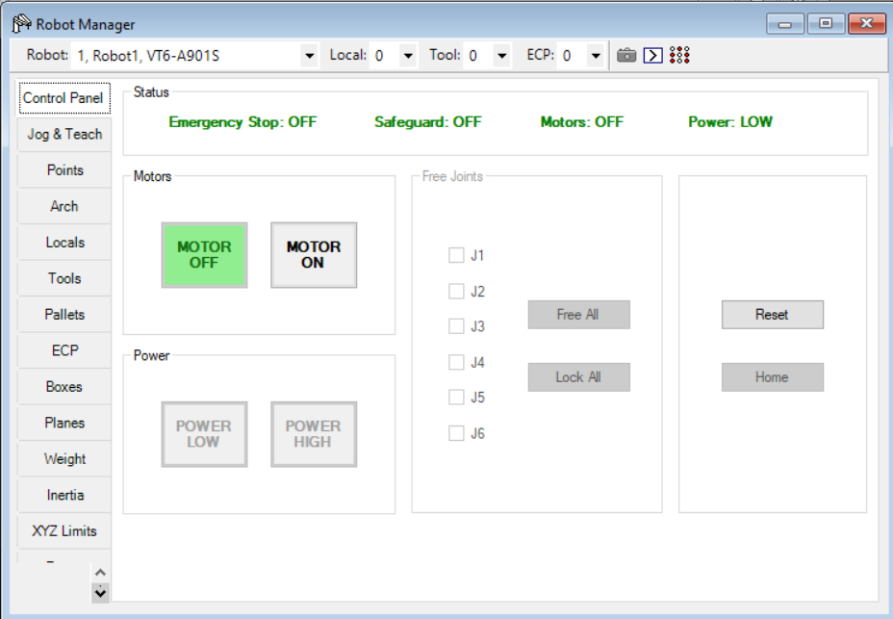
Robot Manager
1)Tools Robot Manager (F6)
Control Panel(MOTOR OFF/ON)(POWER LOW/HIGH)

Slide 9
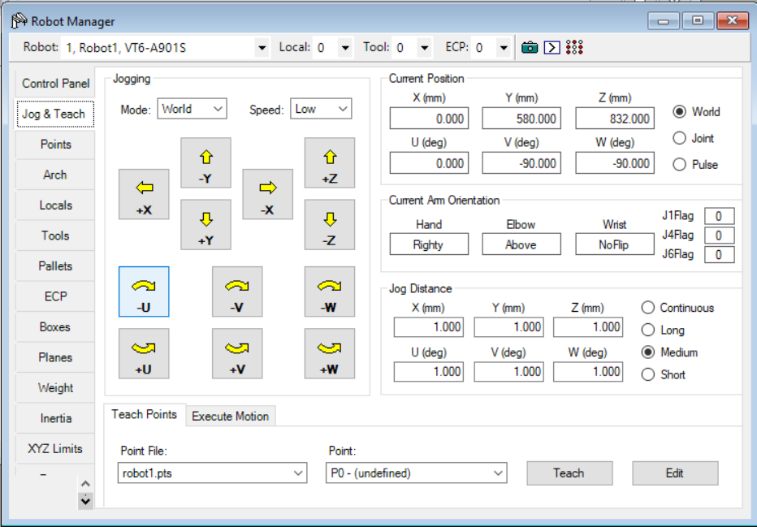
Robot Manager
1)Tools Robot Manager (F6)
Jog & Teach (Jogging/Teach Points/Current Position…)

Slide 10
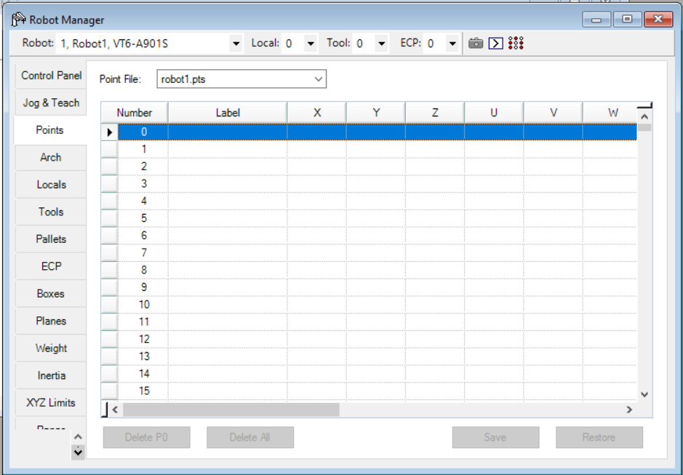
Robot Manager
1)Tools Robot Manager (F6)
Points(Displays the taught point information…)

Slide 11
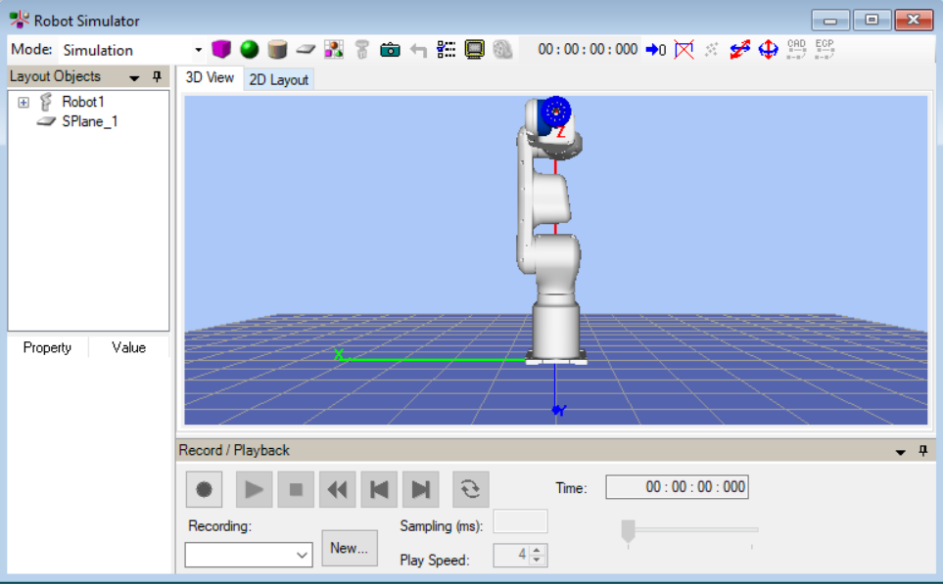
Simulator
On selecting simulator from the toolbar ,simulation environment can be initialized and the child window will be opened.

Slide 12
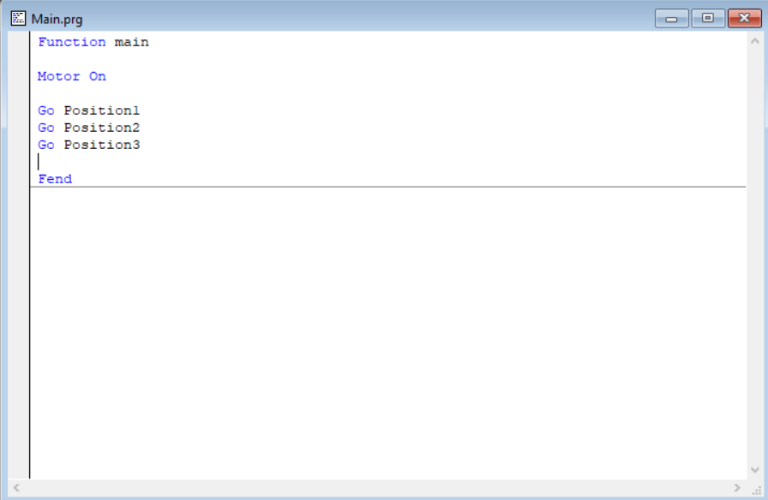
Program Sample
A simple GO program

